Slide 1
THE PRESENTATION · CS6650 Midterm Mastery Part 2 (empirical)
Stress-testing a UDP file-transfer service on AWS
Three experiments: loss × file size, retry budget, autoscaling under load
Nikhil · CS6650 Distributed Systems · Northeastern · November 2026
Notes:
Hi, I'm Nikhil. I deployed the course's file-transfer service on AWS, instrumented it, and ran three experiments: loss versus file size, the retry budget, and autoscaling under load. Spoiler: the biggest problem wasn't a knob we were told to turn.

Slide 2
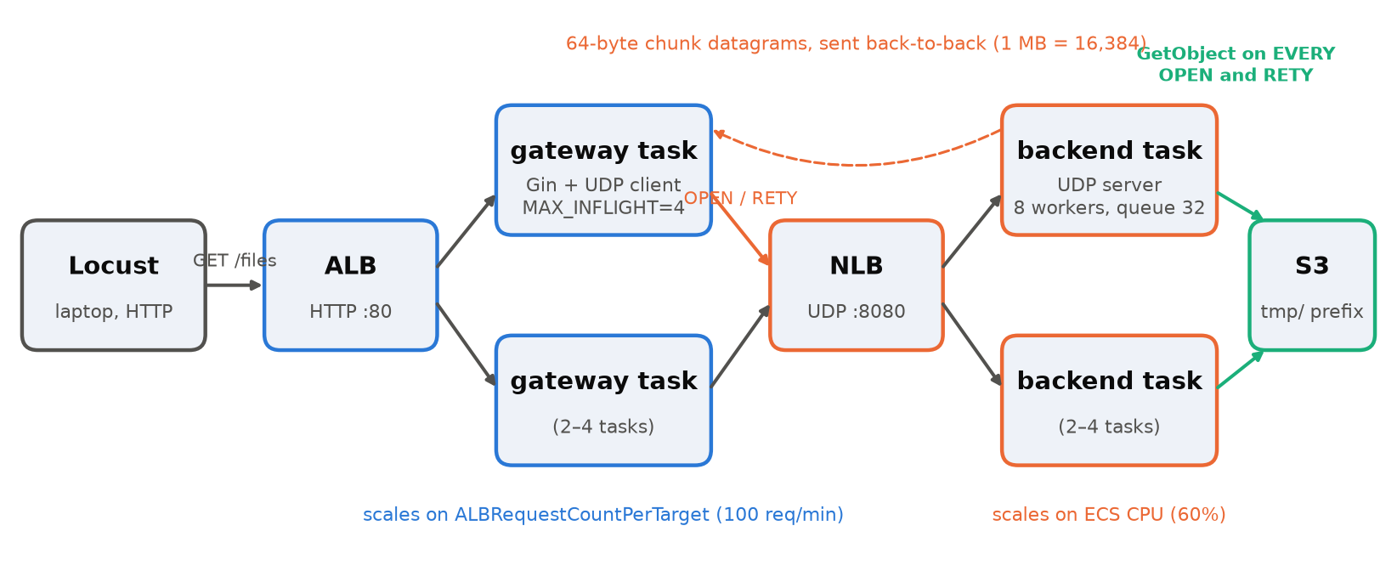
The service: HTTP in front, UDP behind
ALB → gateway (Gin + UDP client) → NLB → backend (UDP server) → S3
Two ECS Fargate services, 0.25 vCPU each, min 2 / max 4 tasks. Files are split into 64-byte datagrams.
Notes:
A client GETs a file from the ALB. A gateway task takes one of four in-flight slots and speaks a custom UDP protocol through an NLB. The backend fetches the file from S3 and blasts it as 64-byte datagrams, and the client asks for missing chunks with RETY. Two details matter. Every RETY re-downloads the whole file from S3, and every round ends with a 2-second quiet timeout.

Slide 3
Knobs, and the three experiments I picked
I added instrumentation: per-request X-* stats headers, CloudWatch EMF counters, and a per-request budget override
 | Varied | Fixed | Measured
E1 loss × size | loss 0/1/5/10/20% × 4 KB/16 KB/64 KB/1 MB | budget 5 opens/5 rounds, 2 users | success, p50/p95/p99, RETYs, drops
E2 retry budget | rounds 1–20; opens 1–10 | 5% loss; 16 KB & 64 KB | success vs p95, RETYs per success
E3 scaling | step load 4→64 users | 4 KB, 1% loss, default targets | task counts, 503s, latency, scale lag
3 × 60 s trials per cell for E1/E2 (1,843 requests); E3 is one 19-minute run (4,370 requests). Total cost ≈ $1–1.5 of Learner Lab credit.
Notes:
I picked one experiment per layer: the network in E1, the client protocol in E2, and the cloud control plane in E3. To measure anything, I added per-request stats headers, CloudWatch counters for both tiers, and a per-request budget override. E1 and E2 cells are three 60-second trials each. The override was essential: it let me sweep nine budgets on the same tasks with no redeploys, so task placement isn't a confound. The whole study cost roughly a dollar or two of Learner Lab credit.

Slide 4
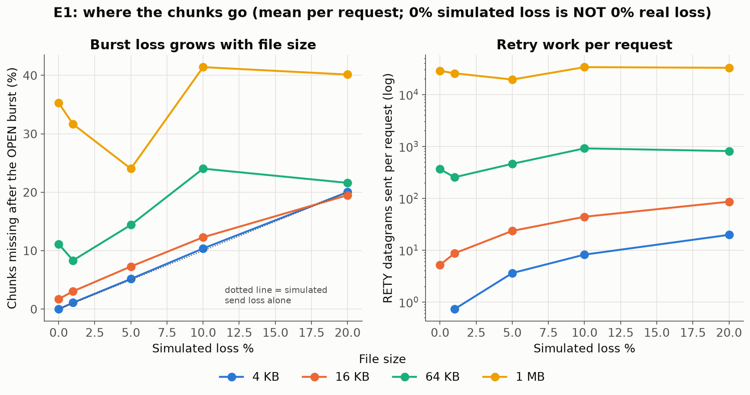
Surprise: 0% simulated loss ≠ 0% loss
Chunks missing after the OPEN burst, with SEND_LOSS = RECV_LOSS = 0
35%
11%
0%
of a 1 MB file lost in the first burst → 0% success
of a 64 KB file lost → 80% success
of a 4 KB file lost → 100% success
Not the NLB: bypassing it, 1 MB still lost 16–29%
Not gateway CPU: with a 1 vCPU gateway, 1 MB still lost 13–40%
Cause: the backend sends every chunk back-to-back with no pacing, so bursts overflow the receiver
Notes:
First surprise: my smoke test at zero simulated loss failed for everything 64 KB and up. 35% of a 1 MB burst never arrived. A bigger gateway still lost, and bypassing the NLB still lost. The backend's sends all succeeded, so unpaced bursts overflow the receiver. 4 KB sits exactly on the simulated-loss line, and bigger files sit 10 to 35 points above it.

Slide 5
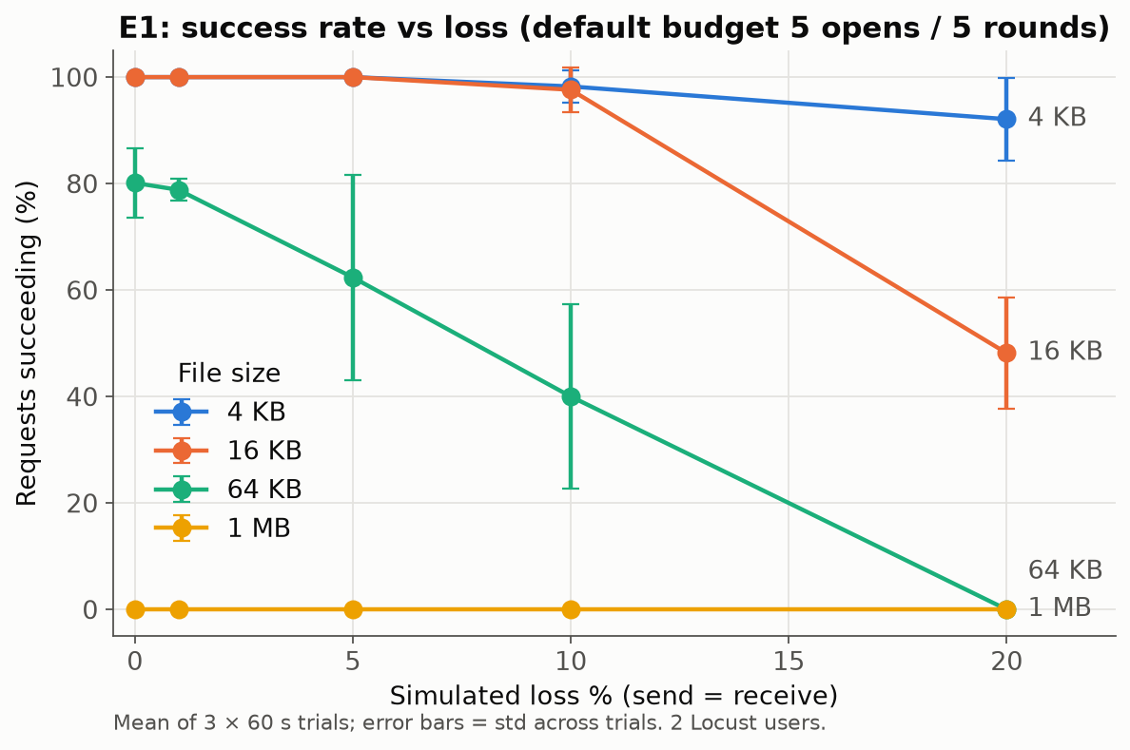
E1: file size amplifies loss
Default budget (5 opens / 5 rounds), 2 Locust users, mean ± std of 3 trials
4 KB: ≥92% even at 20% loss
16 KB: cliff between 10% (98%) and 20% (48%)
64 KB: 80% → 0% across the range
1 MB: 0% everywhere, about 19 s to fail
Latency rises in 2 s steps: p50 2.1 s → 10.2 s (4 KB, 0 → 20%)
Notes:
E1, about a thousand requests. 4 KB barely notices loss. 16 KB is perfect to 10%, then drops to 48% at 20%. 64 KB goes from 80% to zero, and 1 MB never succeeds. Latency comes in 2-second steps, one per round, and failures are the slowest requests of all. Look at 16 KB at 20%: mean retry rounds is 4.55 out of 5, so it's literally running out of budget. And 64 KB fails even before simulated loss, because of the burst loss from the last slide.

Slide 6
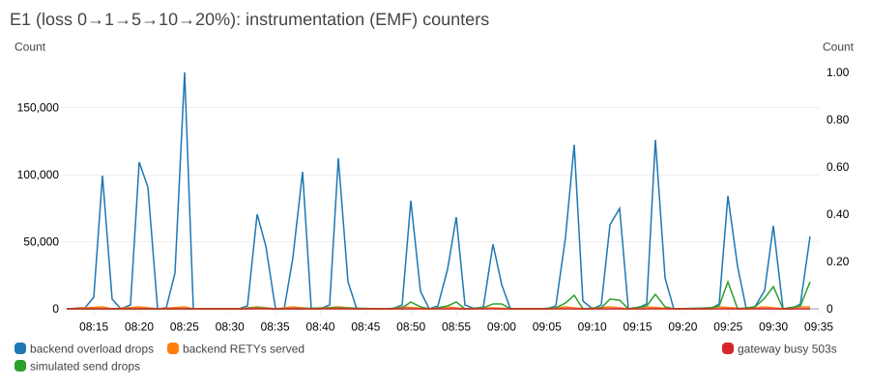
E1: why retries can't catch up
Instrumentation (EMF) counters across E1; spikes = 1 MB runs
Each RETY = a full S3 GET: 31 ms (16 KB) → 155 ms (1 MB)
Queue = workers × 4 = 32: the rest are dropped silently
1 MB: 411k RETYs dropped vs 4.4k served in one cell
Orphaned work: the backend keeps serving RETYs after the client gave up
Notes:
Why don't retries fix it? The client fires thousands of RETYs at once. The backend has 8 workers and a 32-slot queue, and each RETY costs an S3 GET, 155 ms for 1 MB. So about 98% are dropped: those blue spikes. And the backend keeps serving stale RETYs after a client gives up. In the 1 MB cells the backend dropped about 411 thousand RETYs and served only 4.4 thousand. Each round can recover only around 40 chunks, so no reasonable round count catches up with thousands of missing chunks.

Slide 7
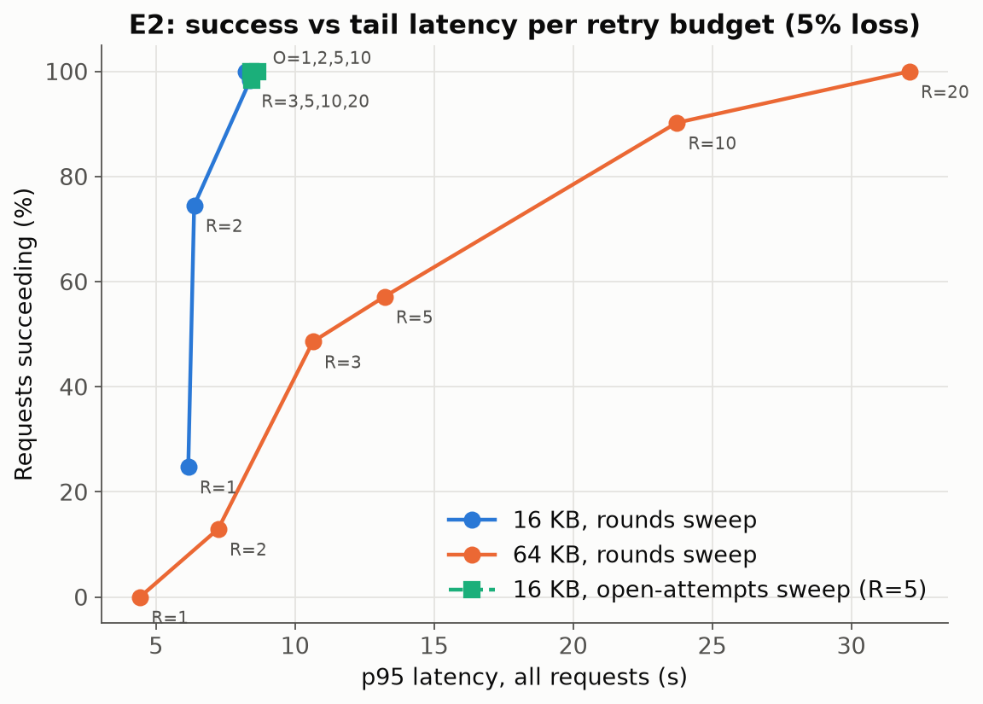
E2: rounds buy success, paid for in tail latency
5% loss; each point is one budget (R = retry rounds, O = open attempts)
16 KB: R = 3 gives 98%; the default 5 is fine
64 KB: default R = 5 gives 57%, R = 20 gives 100% but p95 32 s
Open attempts: O = 1 gave 98%, O = 2…10 gave 100% (≈1.05 OPENs per request)
R > ~25 would hit the ALB's 60 s idle timeout
Notes:
E2 fixes loss at 5% and sweeps the budget. For 16 KB, three rounds already give 98%. For 64 KB, the default five rounds give 57%, and twenty give 100%, but at a p95 of 32 seconds. Open attempts barely matter. So the default suits small files, and raising it just trades fast failures for slow successes. Look at the curve on the right: every extra round adds about 2 seconds of tail, and above roughly 25 rounds the ALB's 60-second idle timeout would cut the request off anyway.

Slide 8
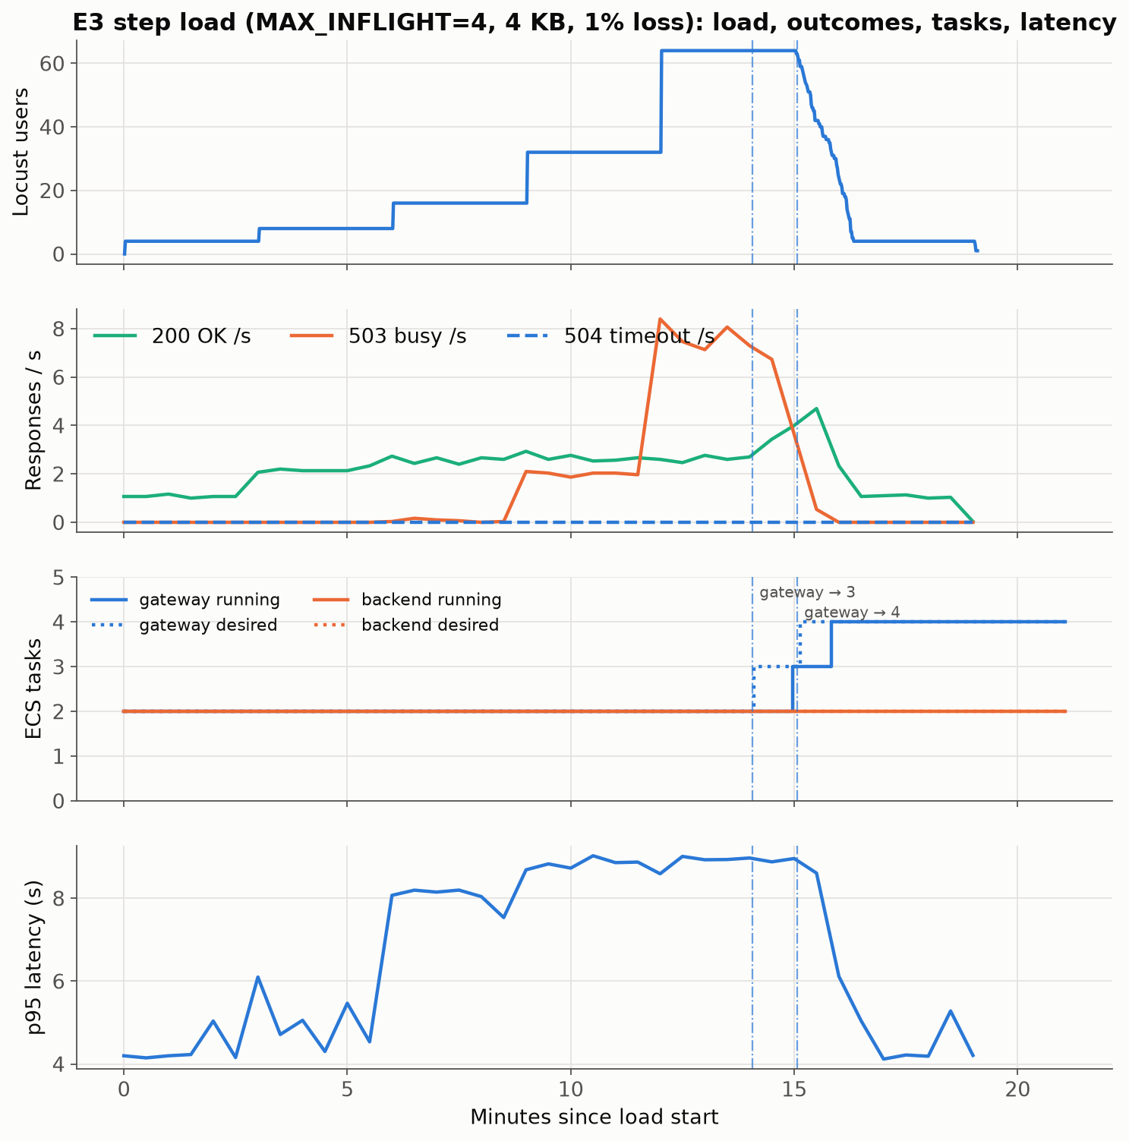
E3: the gateway scales on its own rejections
Step load 4 → 64 users, 4 KB, 1% loss, stock thresholds; ECS polled every 10 s
Hard ceiling: 2 tasks × 4 slots ÷ ~3 s ≈ 2.7 OK/s, flat from 16 users on
Before scaling: 73% of requests are 503s at 64 users
Trigger: OK-only traffic peaked at 82 req/min/target < 100; 503s pushed it to 128+
Lag: ~5 min to the first scale-out, ~7 min to 4 tasks; 1,771 requests rejected meanwhile
Notes:
E3 steps users up every 3 minutes. Two gateway tasks cap at about 2.7 successes per second, and beyond that requests get 503s. Successful traffic alone never crossed the scaling target. The scaler fired only because 503s inflated the request count, about 5 minutes late, and 1,771 requests were rejected meanwhile. You can see it in the second panel: green, the successes, stays flat at 2.7 per second while orange, the 503s, climbs to 8 per second. Once four tasks were up, successes jumped to 4.7 per second, just as the load step ended.

Slide 9
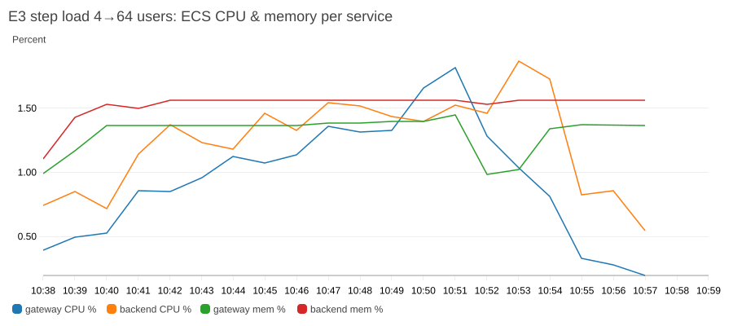
E3: CPU scaling is blind here
Peak values during the 64-user step
2.9%
7 / 8
1.8%
backend CPU max (target 60%), so the backend never scaled
backend workers busy at peak: the pool was nearly full
gateway CPU max: CPU scaling would never fire here either
Both tiers are I/O- and timer-bound: 2 s quiet waits and S3 GETs, not computation
The NLB has no request metric, so the backend falls back to CPU, which never moves
Scale-in not seen in-window: AlarmLow needs 15 low minutes; the cooldown change can't shorten that
Zero 504s: under load the failure is admission (503), not transfer
Notes:
The backend never scaled. CPU stayed under 3% while 7 of 8 workers were busy. Both tiers wait on timeouts and S3 rather than compute, and the NLB offers no request metric. Scale-in also needs 15 quiet minutes, which a cooldown change can't shorten. My instrumentation counters, busy workers and overload drops, are exactly the custom metrics a scaling policy should track here.

Slide 10
Takeaways and recommendations
1
Pace the OPEN burst, or use bigger chunks
64-byte datagrams sent back-to-back lose 11–35% for files ≥ 64 KB before any simulated loss; 1 KB chunks would mean 16× fewer packets
2
Make RETY cheap: cache the file per transfer, batch the IDs
one S3 GET per RETY plus a 32-slot queue drops ~98% of retries; caching turns a 155 ms GET into a memory copy
3
Size-aware retry budget; keep open attempts low
R = 3 suffices ≤ 16 KB; 64 KB needs R ≈ 10–20; 1 open attempt was as good as 10
4
Scale on the real bottleneck, and don't let 503s drive it
gateway: in-flight utilisation or queue wait (EMF) instead of raw request count; backend: BusyWorkers / OverloadDrops instead of CPU; raise MAX_INFLIGHT, since tasks idle at under 2% CPU
Notes:
Four recommendations. Pace the burst or use bigger chunks. Cache the file per transfer so a RETY is cheap. Make the retry budget size-aware. And scale each tier on what actually saturates, in-flight slots and busy workers, not 503-inflated request counts or idle CPU. Thanks!

